Slide 1
LA 558: Tech Report
Open Street Map
Yu Tian

Slide 2
Introduction
OpenStreetMap (OSM) is
a collaborative project to create a free editable map.
built by a community of mappers that contribute and maintain data about roads, trails, cafés, railway stations, and much more, all over the world.
a prominent example of volunteered geographic information.

Slide 3
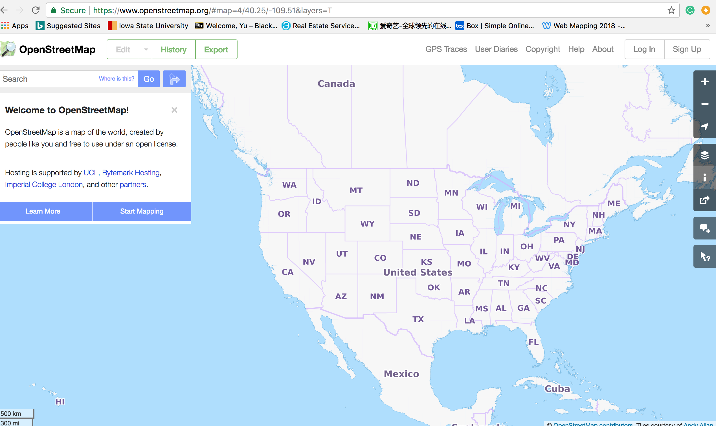
On the website of OSM, you can zoom in and out as well as locate yourself. There are four major map layers you can choose as your layers. Each layer may contain related key factors.

Slide 4
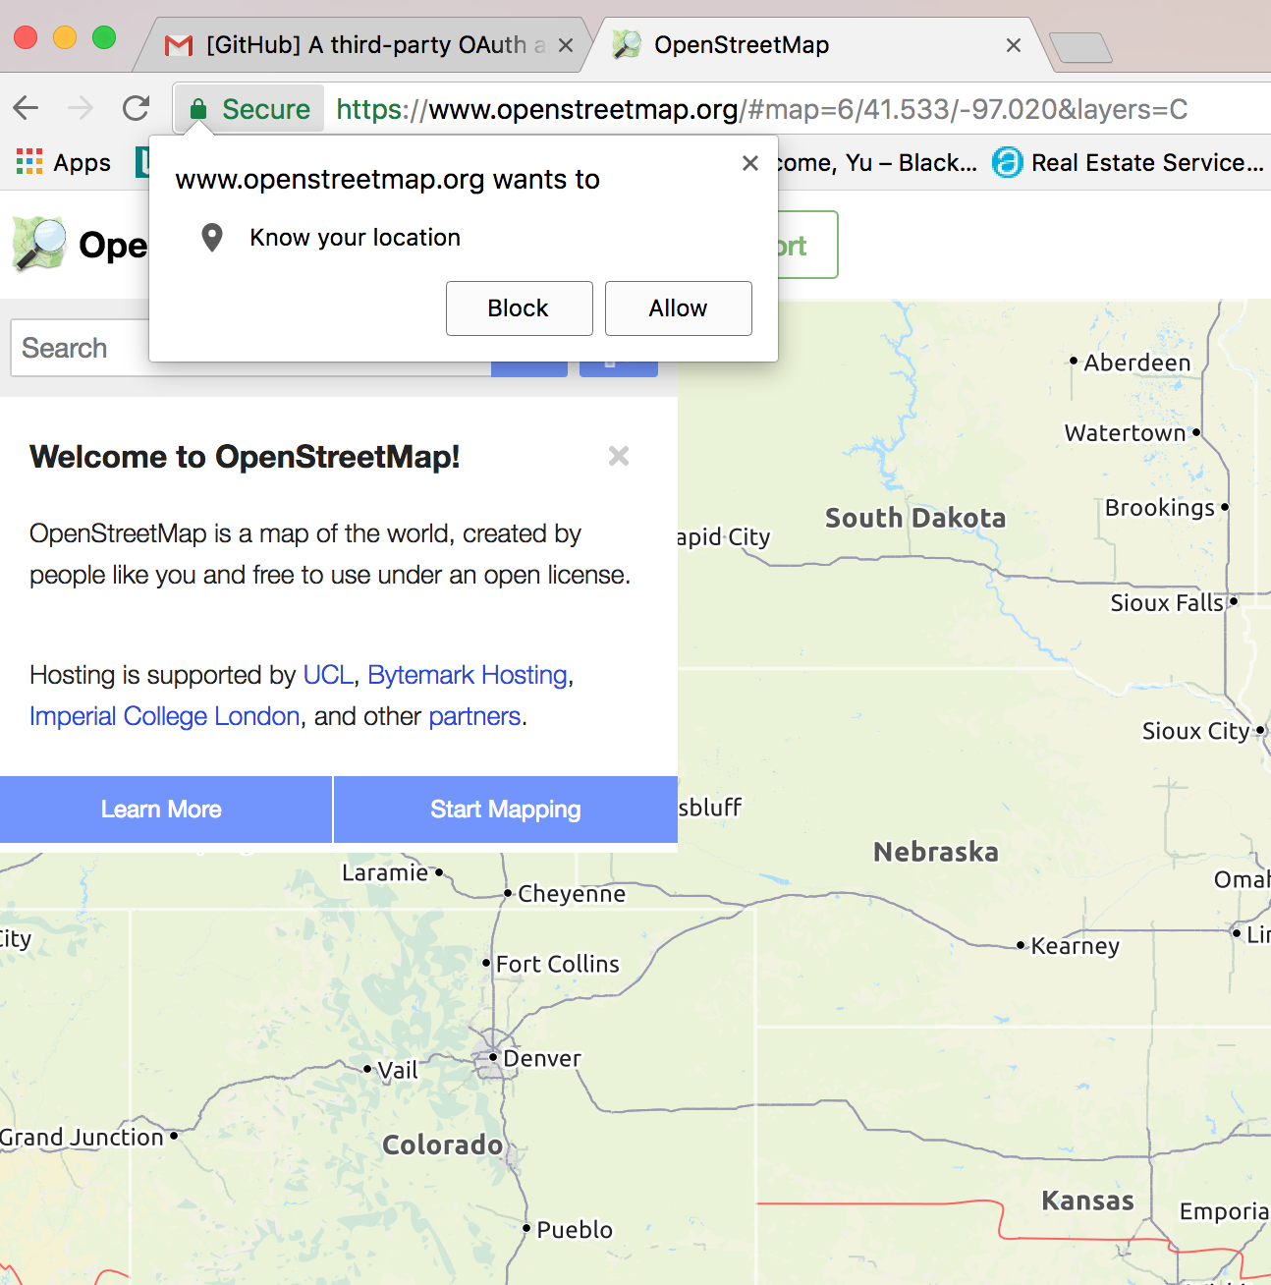
When you click on “Show My Location”, the website will have a pop-up and ask you whether give the permission to let OSM access your current location

Slide 5
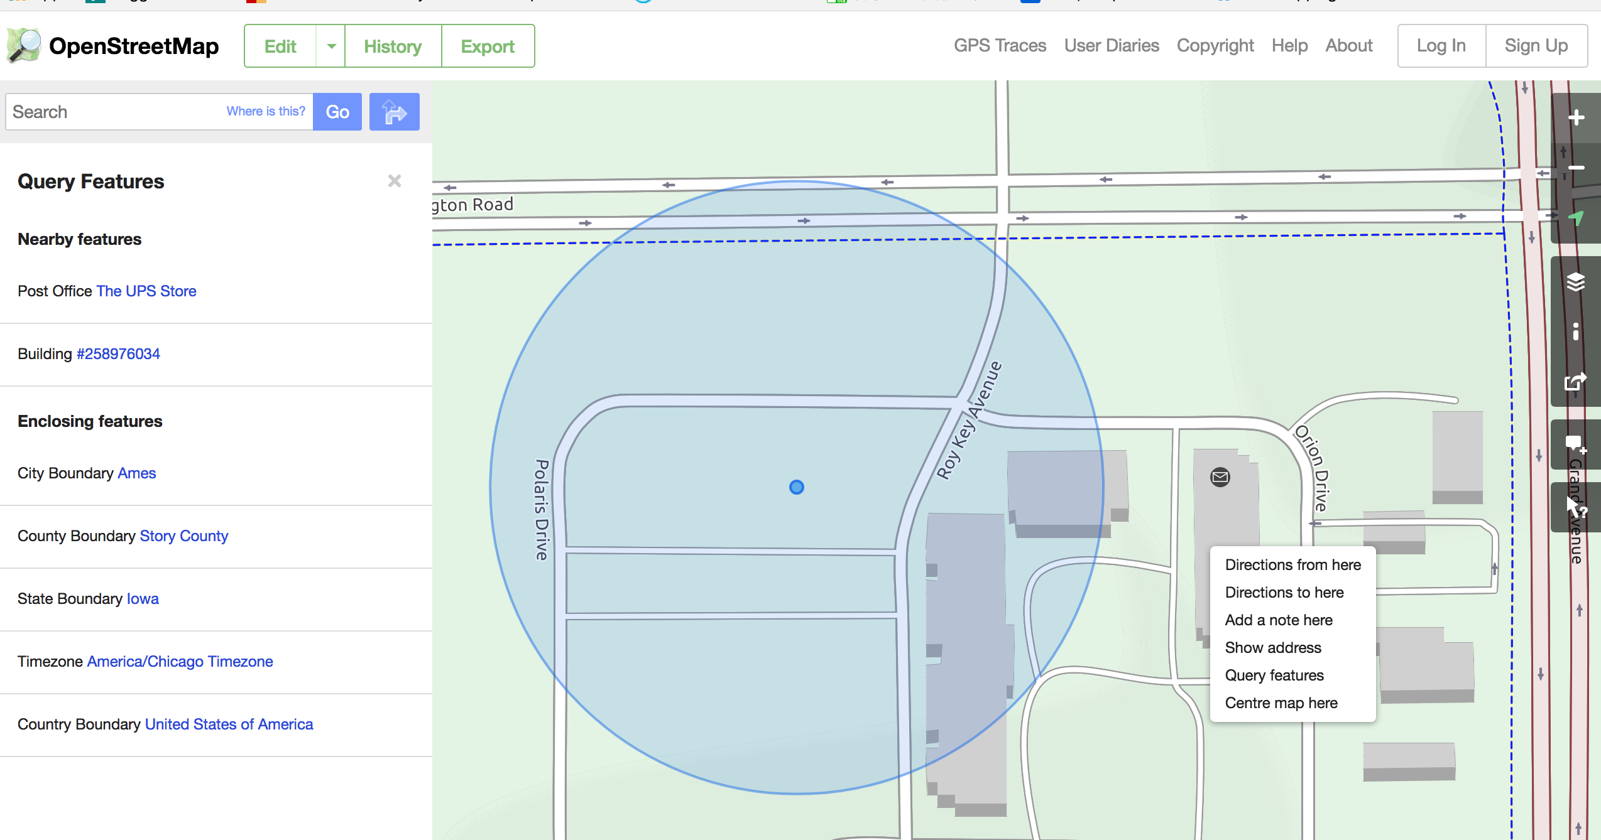
After you give the permission to access you location, right click, you will have more choices interacting with current map. The example presents above, I select query feature, and then, nearby feature as well as enclosing feature will show up.

Slide 6
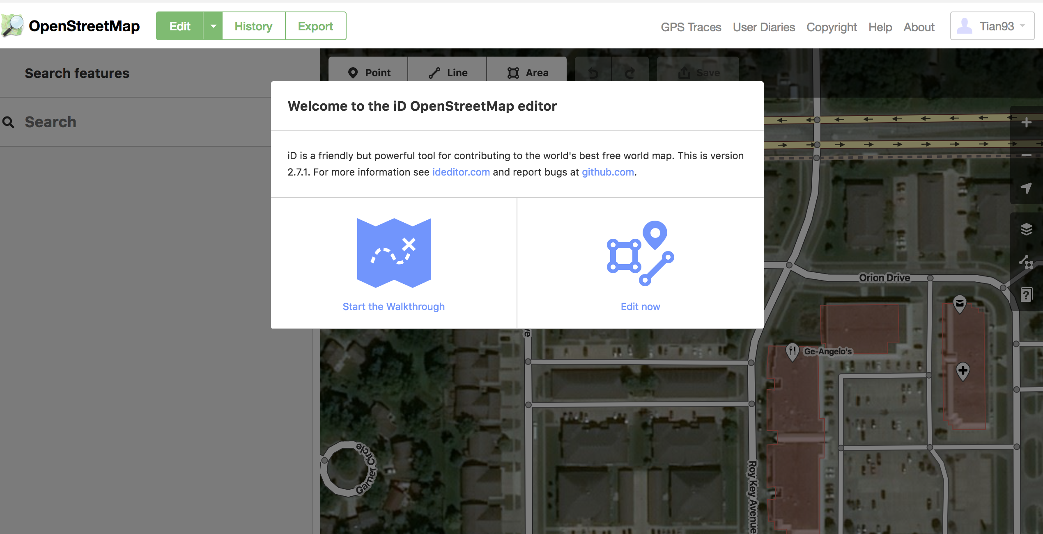
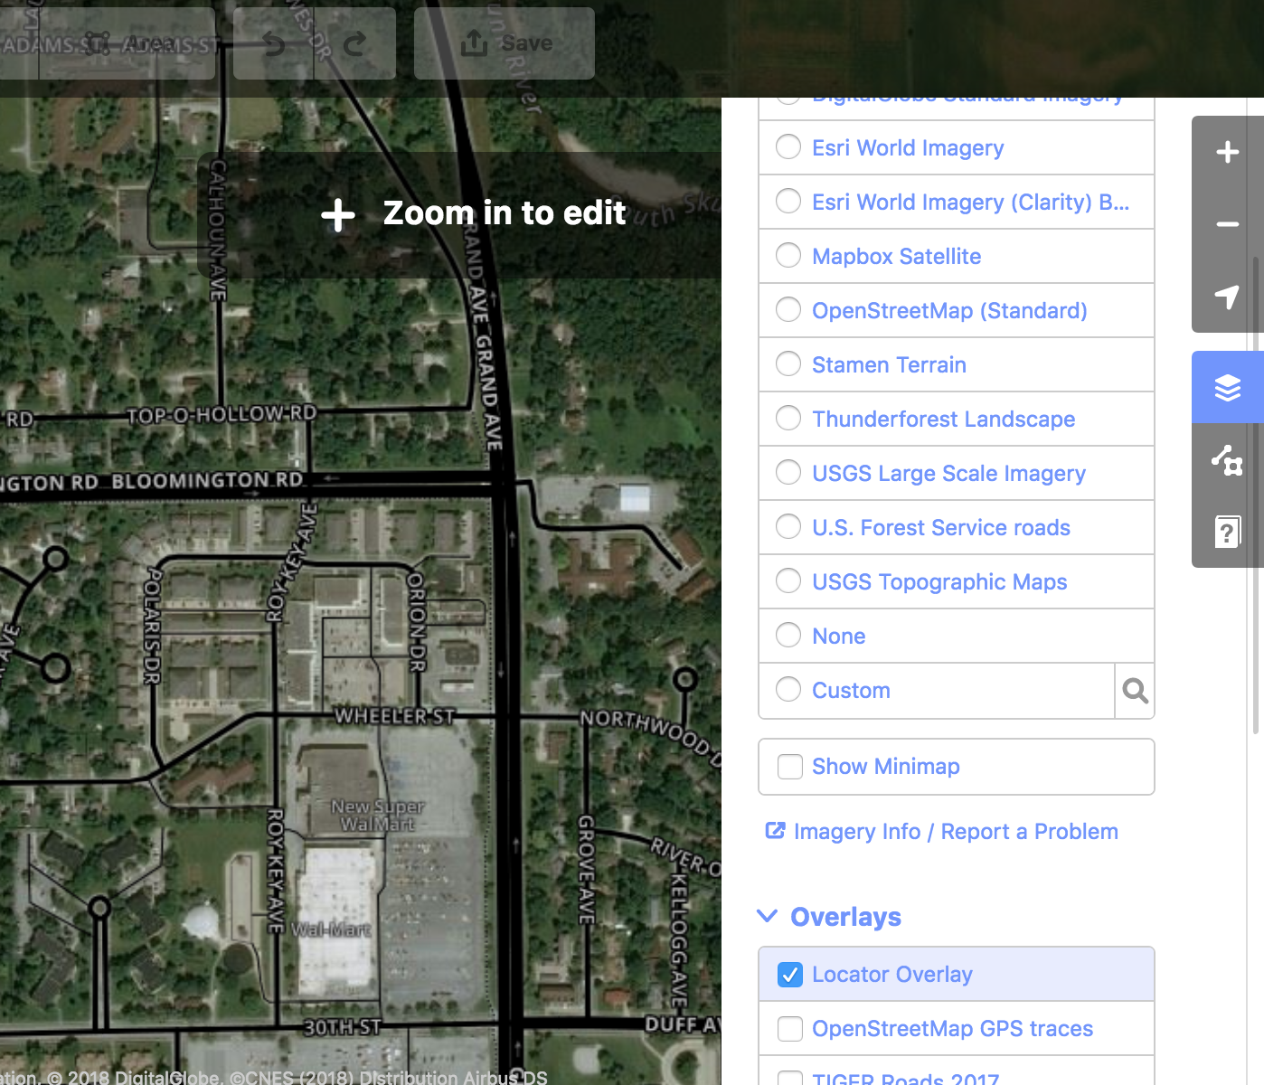
After you sign up the account of OSM, actually, you can start to be one of the contributors. Besides, you can access more maps based on your needs in higher resolution.

Slide 7
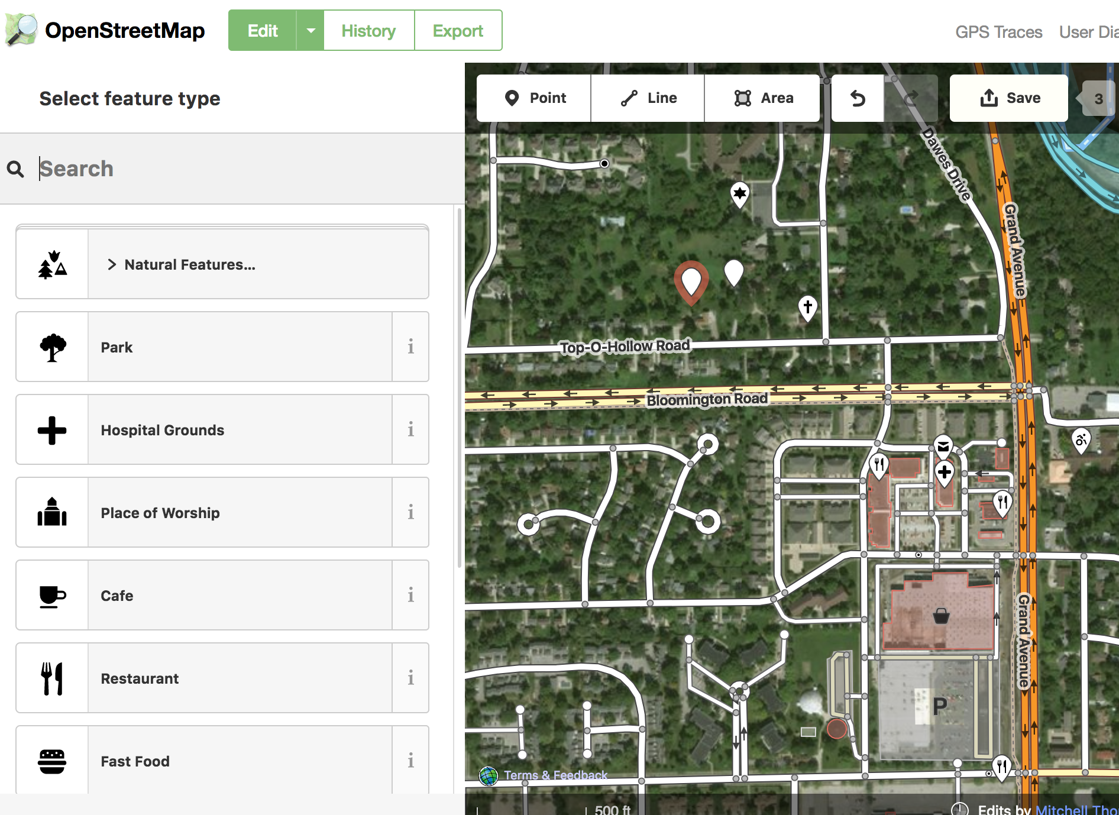
You can add markers, draw routes, plot polygons to add features to the maps as a contributor. As a transportation engineering major, I can edit/add traffic info to specific routes, assign crash locations, etc.

Slide 8
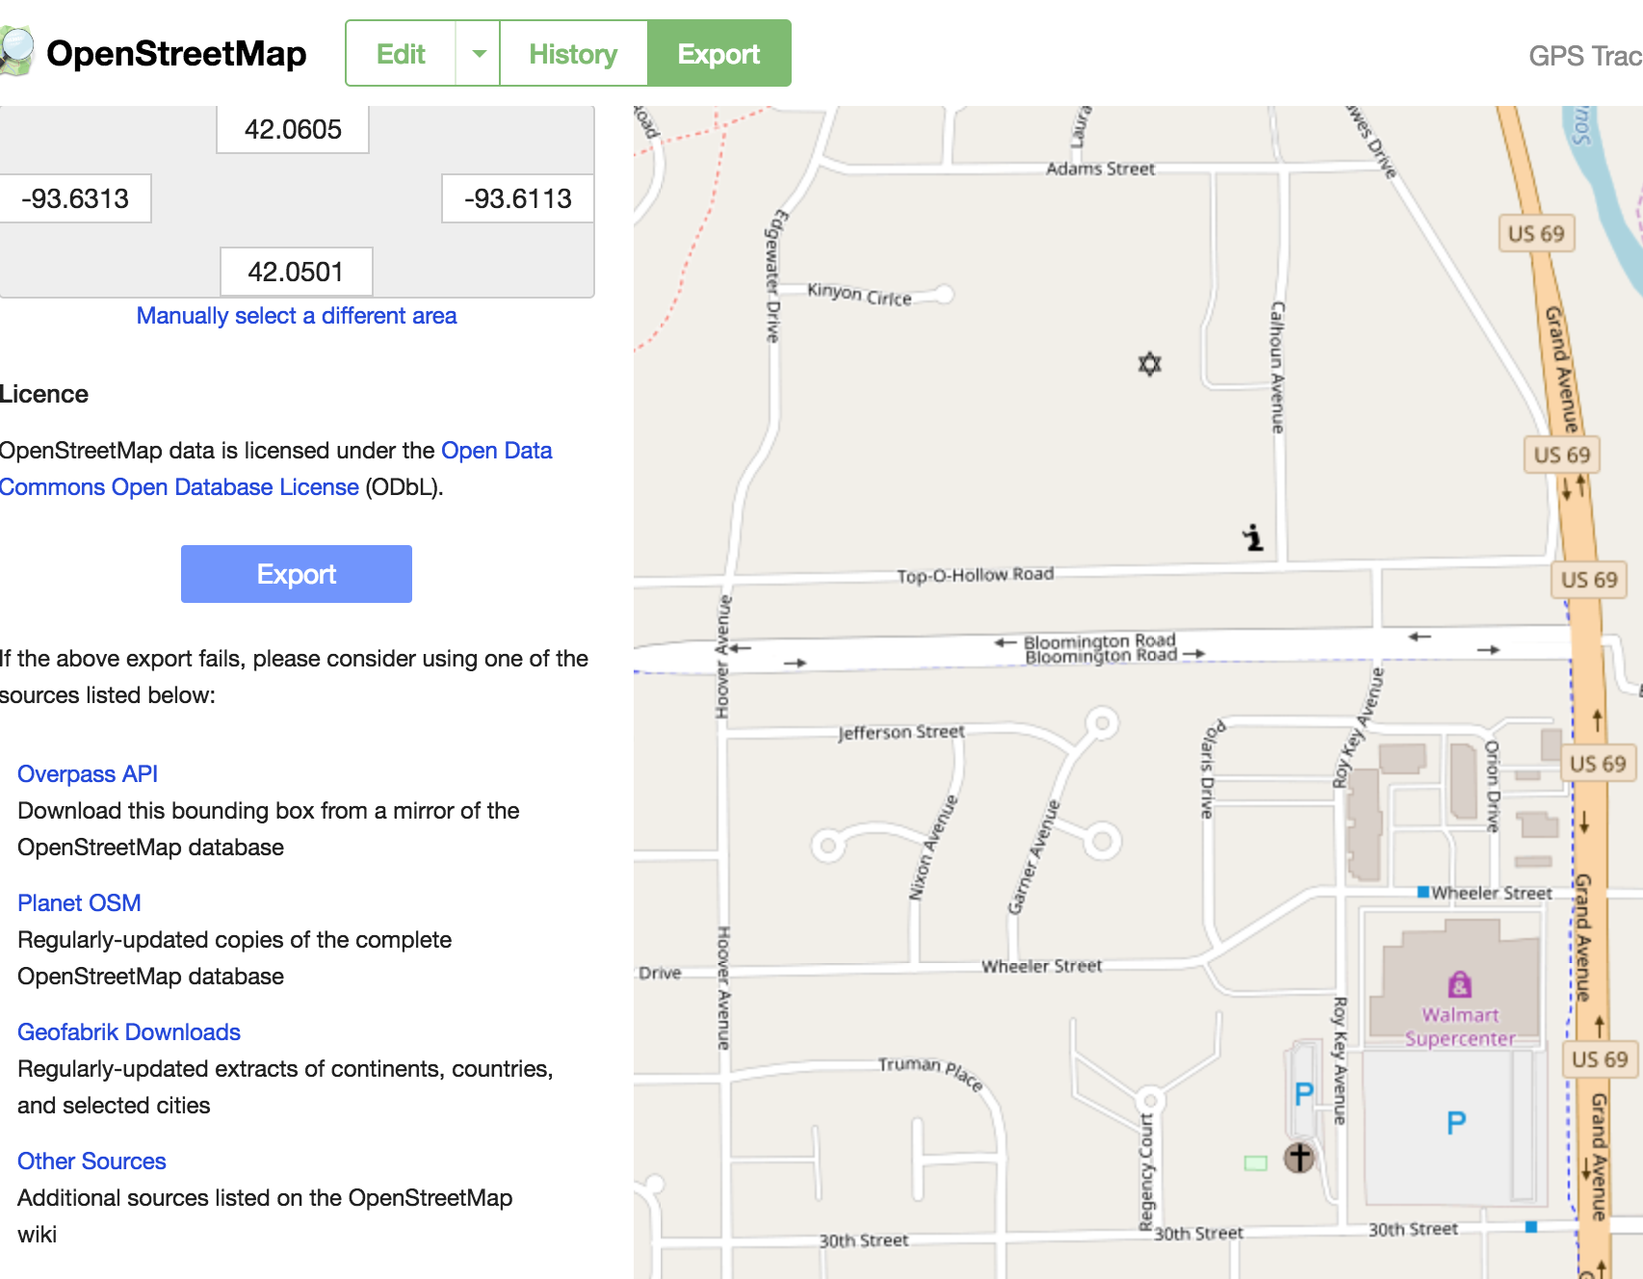
Eventually, you can export the map for your future use

Slide 9
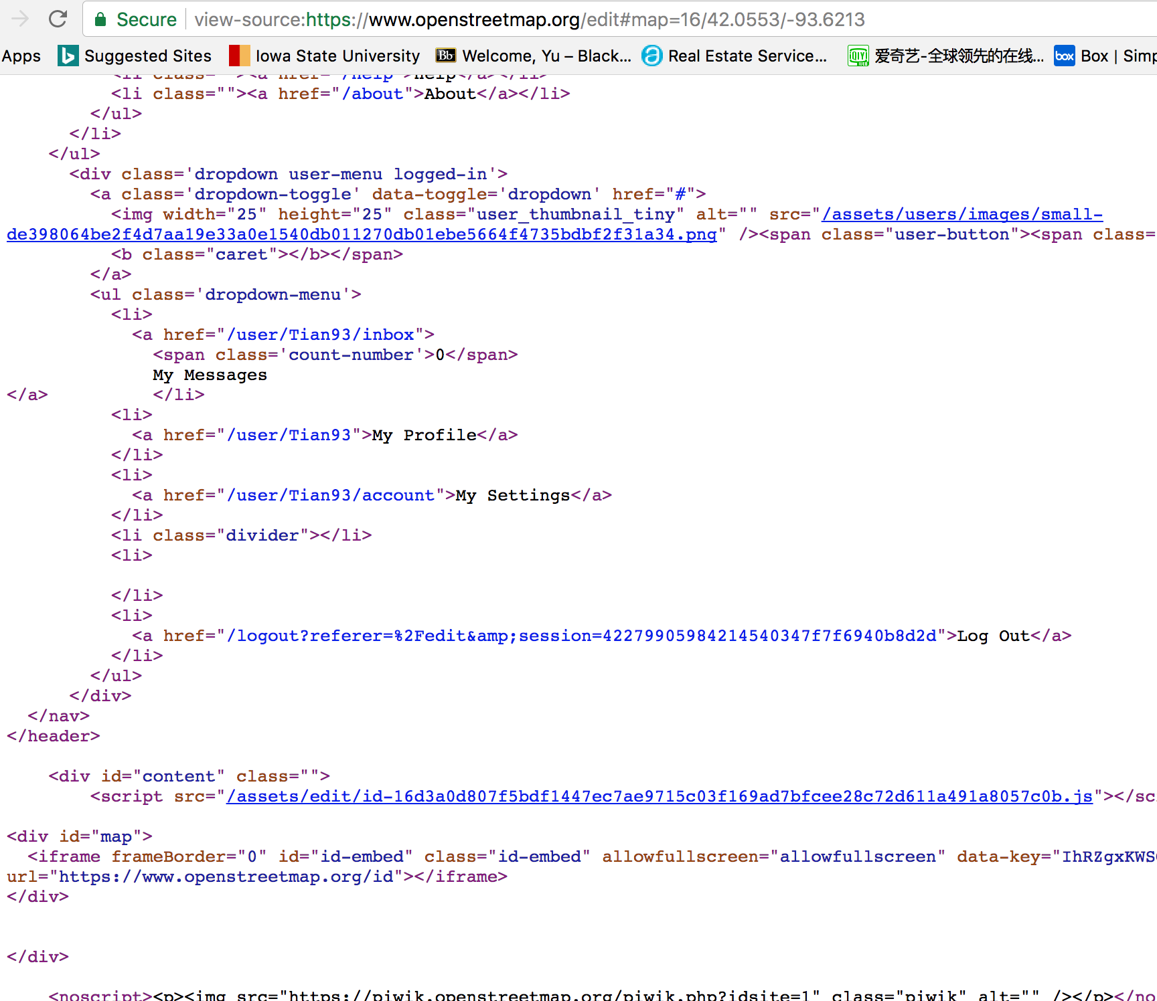
OSM should be our most familiar map , either in the lecture jsbin, or our assignments. OSM is always the first choice as base map. So far, two more weeks left, when you right click to see the page source. You will find that those format, function, etc. are not unfamiliar.

Slide 10
Inspiration for final project
Multi-task page (Provide enough data, and give chance to user play with the data base)
Multi pages (not limit on one page, more pages for info/intro/help/contact info)
More interaction bar
User design the display of the map (such as change the markers, color distribution.)
Zoom in & out
Self location (Geolocation needed)

